Slide 1
UniProt:
The Universal
Protein Knowledgebase

Slide 2
About UniProt
The Universal Protein Resource (UniProt) is the central hub for the collection of functional information on proteins with accurate, consistent, and rich annotation.
Captures core data mandatory for each UniProt entry: amino acid sequence, protein name or description, taxonomic data, citation information and as much annotation information is added.
The database contains over 60 million sequences, of which over half a million sequences have been curated by experts who critically review experimental and predicted data for each protein.
UniProt is a comprehensive resource for protein sequence and annotation data. The UniProt databases are the UniProt Knowledgebase (UniProtKB), the UniProt Reference Clusters (UniRef), and the UniProt Archive (UniParc).

Slide 3
The people and funding behind UniProt
UniProt is a collaboration between the European Bioinformatics Institute (EMBL-EBI), the SIB Swiss Institute of Bioinformatics and the Protein Information Resource (PIR).
Across the three institutes more than 100 people are involved through different tasks such as database curation, software development and support.
The UniProt consortium is headed by Alex Bateman (PI), Cathy Wu, and Alan Bridge, supported by key staff, and receives valuable input from an independent Scientific Advisory Board.
UniProt is supported by the National Eye Institute (NEI), National Human Genome Research Institute (NHGRI), National Heart, Lung, and Blood Institute (NHLBI), National Institute of Allergy and Infectious Diseases (NIAID), National Institute of Diabetes and Digestive and Kidney Diseases (NIDDK), National Institute of General Medical Sciences (NIGMS), and National Institute of Mental Health (NIMH) of the National Institutes of Health (NIH).

Slide 4
https://www.google.com/url?sa=i&source=images&cd=&cad=rja&uact=8&ved=2ahUKEwii1vzz2pHhAhWFMd8KHRiwAeoQjRx6BAgBEAU&url=https%3A%2F%2Fwww.slideserve.com%2Ftuari%2Funiprot-universal-protein-resource&psig=AOvVaw1Mhjk2IY4isx7MtoMft-s1&ust=1553204618984898

Slide 5
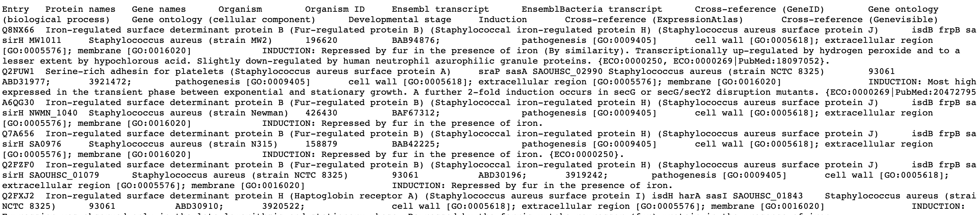
About dataset:
Uniprot dataset for Staphylococcus aureus: (total number of rows 124,980)
UniProt entries where table will join BacMet

Slide 6
Goals of UniProt
The accelerating growth of sequenced genomes poses great challenges for databases with their major growth being driven by sequencing of very similar and almost identical strains of the same bacterial species.
UniProt provides a method to identify and remove highly redundant bacterial proteomes within species groups by performing pairwise alignments of sets of sequences and applies graph theory to find dominating sets that result in removal of redundant bacterial proteomes.

Slide 7
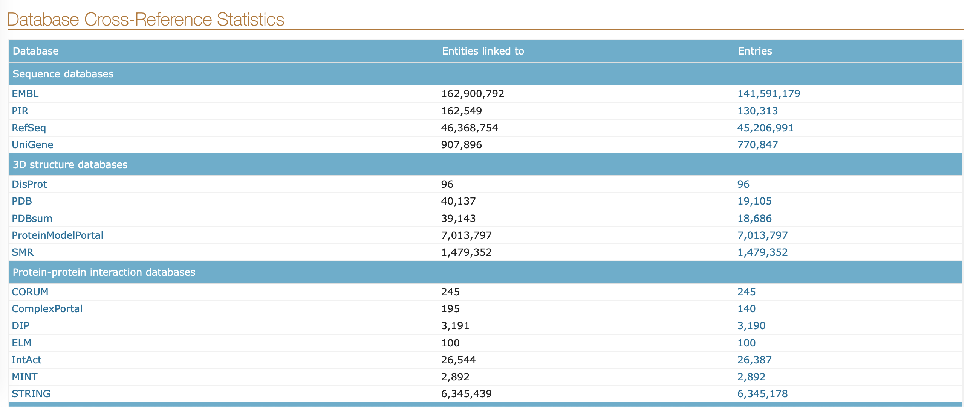
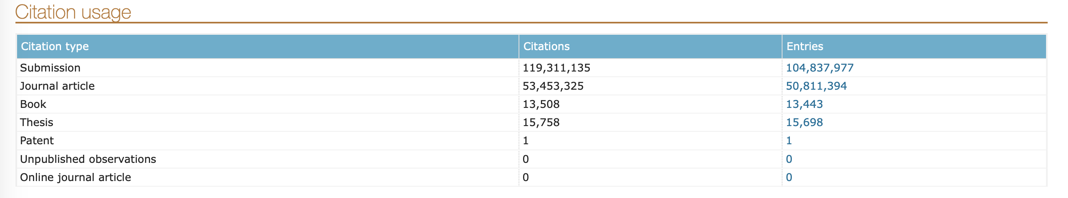
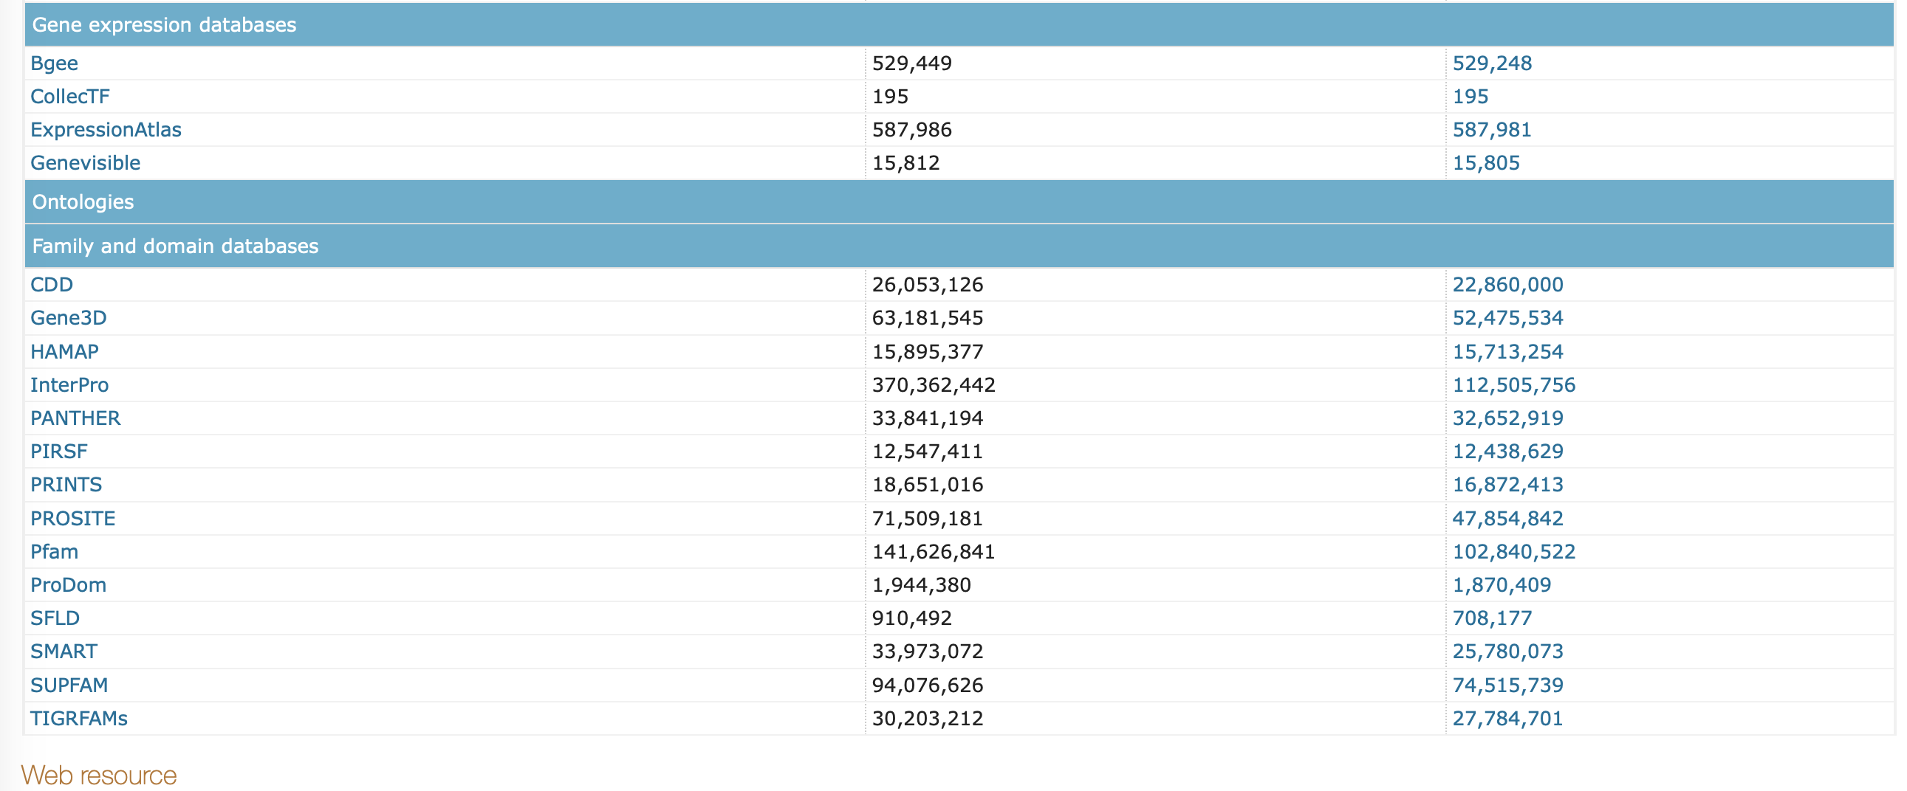
UniProt Stats

Slide 8
References:
https://2rdnmg1qbg403gumla1v9i2h-wpengine.netdna-ssl.com/wp-content/uploads/sites/3/2017/10/mrsa-650x450.jpg
The UniProt Consortium (2016). UniProt: the universal protein knowledgebase. Nucleic acids research, 45(D1), D158-D169.
The UniProt Consortium UniProt: a worldwide hub of protein knowledge Nucleic Acids Res. 47: D506-515 (2019)
https://www.google.com/url?sa=i&source=images&cd=&cad=rja&uact=8&ved=2ahUKEwii1vzz2pHhAhWFMd8KHRiwAeoQjRx6BAgBEAU&url=https%3A%2F%2Fwww.slideserve.com%2Ftuari%2Funiprot-universal-protein-resource&psig=AOvVaw1Mhjk2IY4isx7MtoMft-s1&ust=1553204618984898

